Slide 1
Business Statistics:
A First Course
(3rd Edition)
Chapter 5
Probability Distributions

Slide 2
Chapter Topics
The Probability of a Discrete Random Variable
Covariance and its Applications in Finance
Binomial Distribution
The Normal Distribution
The Standardized Normal Distribution
Evaluating the Normality Assumption

Slide 3
Random Variable
Random Variable
  Outcomes of an experiment expressed numerically
  e.g. Toss a die twice; count the number of times the number 4 appears (0, 1 or 2 times)

Slide 4
Discrete Random Variable
Discrete Random Variable
  Obtained by Counting (0, 1, 2, 3, etc.)
  Usually a finite number of different values
  e.g. Toss a coin 5 times; count the number of tails (0, 1, 2, 3, 4, or 5 times)

Slide 5



Discrete Probability Distribution Example
Event: Toss 2 Coins. Count # Tails.
Probability Distribution
Values Probability
0 1/4 = .25
1 2/4 = .50
2 1/4 = .25
T
T
T
T

Slide 6
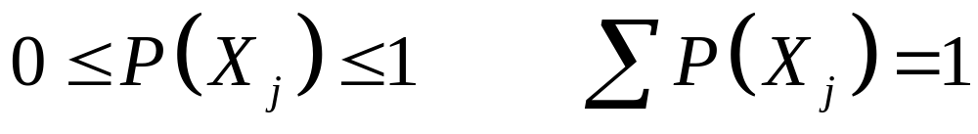
Discrete Probability Distribution
List of All Possible [X_{j} , P(X_{j}) ] Pairs
  X_{j} = Value of random variable
  P(X_{j}) = Probability associated with value
Mutually Exclusive (Nothing in Common)
Collective Exhaustive (Nothing Left Out)

Slide 7
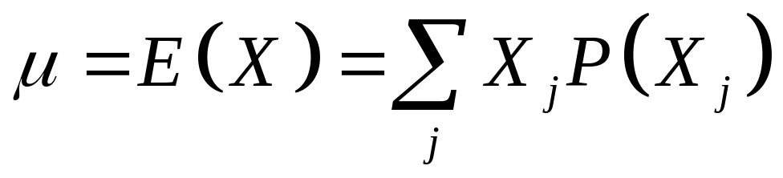
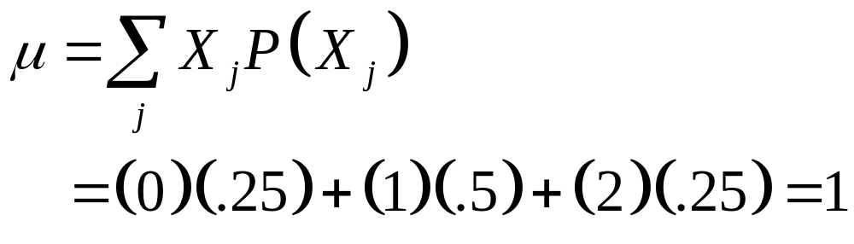
Summary Measures
Expected value (The Mean)
  Weighted average of the probability distribution
  e.g. Toss 2 coins, count the number of tails, compute expected value

Slide 8
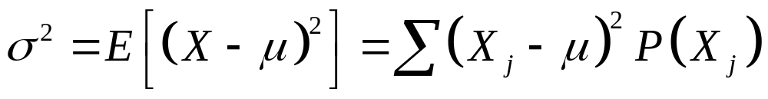
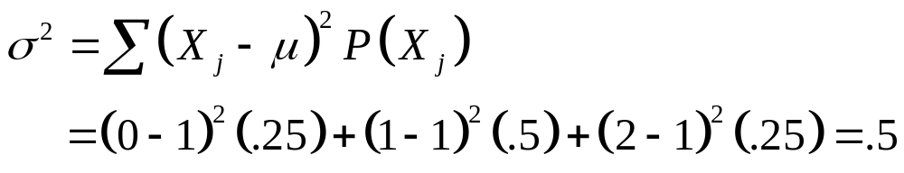
Summary Measures
(continued)
Variance
  Weighted average squared deviation about the mean
  e.g. Toss 2 coins, count number of tails, compute variance

Slide 9
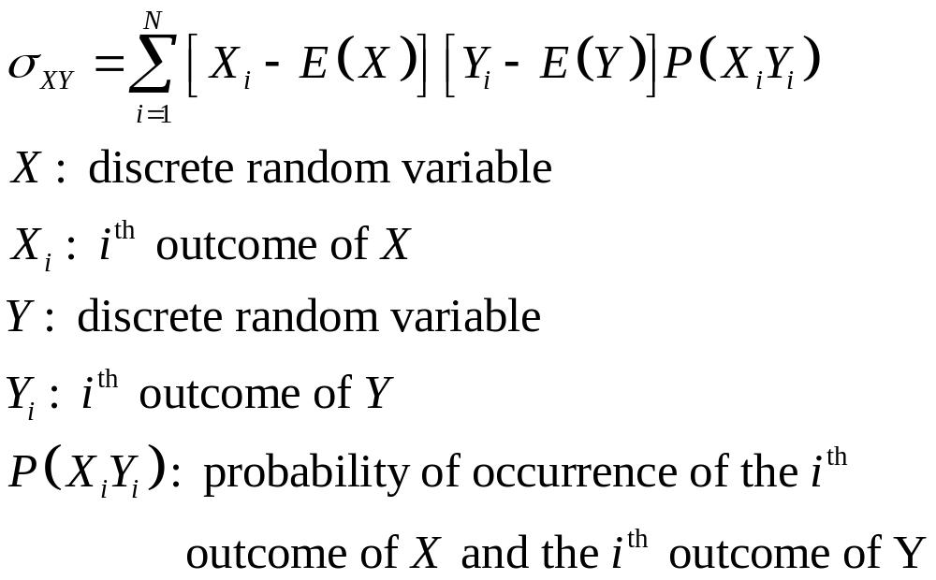
Covariance and its Application

Slide 10
Computing the Mean for Investment Returns
Return per $1,000 for two types of investments
Investment
P(X_{i}) P(Y_{i}) Economic condition Dow Jones fund X Growth Stock Y
.2 .2 Recession -$100 -$200
.5 .5 Stable Economy + 100 + 50
.3 .3 Expanding Economy + 250 + 350

Slide 11
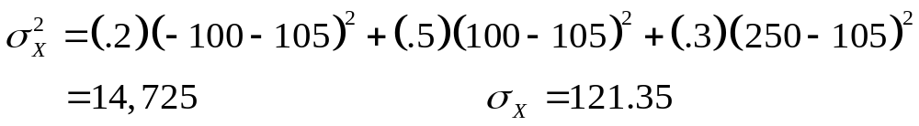
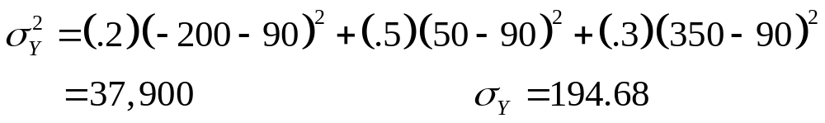
Computing the Variance for Investment Returns
Investment
P(X_{i}) P(Y_{i}) Economic condition Dow Jones fund X Growth Stock Y
.2 .2 Recession -$100 -$200
.5 .5 Stable Economy + 100 + 50
.3 .3 Expanding Economy + 250 + 350

Slide 12
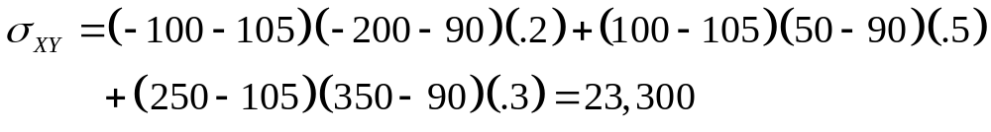
Computing the Covariance for Investment Returns
Investment
P(X_{i}Y_{i}) Economic condition Dow Jones fund X Growth Stock Y
.2 Recession -$100 -$200
.5 Stable Economy + 100 + 50
.3 Expanding Economy + 250 + 350
The Covariance of 23,000 indicates that the two investments are positively related and will vary together in the same direction.

Slide 13
Important Discrete Probability Distributions
Discrete Probability Distributions
Binomial

Slide 14
Binomial Probability Distribution
‘n’ Identical Trials
  e.g. 15 tosses of a coin; 10 light bulbs taken from a warehouse
2 Mutually Exclusive Outcomes on Each Trial
  e.g. Head or tail in each toss of a coin; defective or not defective light bulb
Trials are Independent
  The outcome of one trial does not affect the outcome of the other

Slide 15
Binomial Probability Distribution
(continued)
Constant Probability for Each Trial
  e.g. Probability of getting a tail is the same each time we toss the coin
2 Sampling Methods
  Infinite population without replacement
  Finite population with replacement

Slide 16
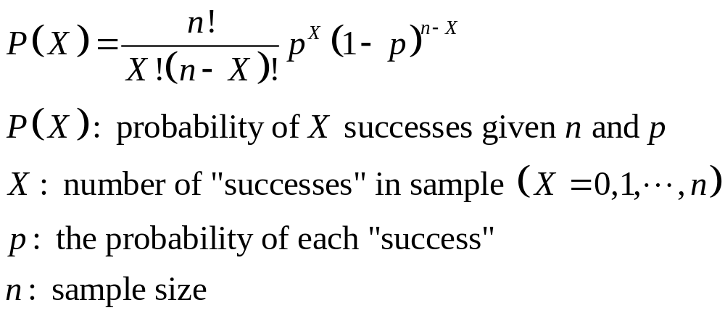
Binomial Probability Distribution Function
Tails in 2 Tosses of Coin
X P(X)
0 1/4 = .25
1 2/4 = .50
2 1/4 = .25

Slide 17
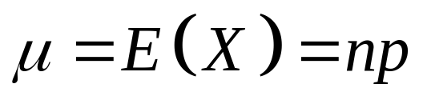
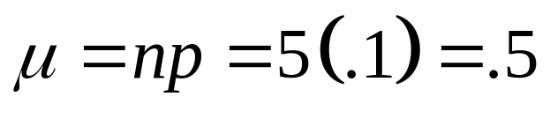
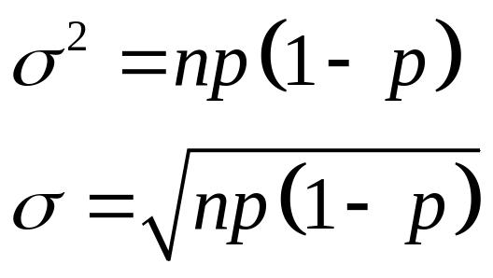
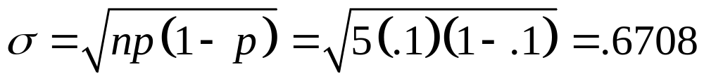
Binomial Distribution Characteristics
Mean
  E.g.
Variance and
Standard Deviation
  e.g.
P(X)
n = 5 p = 0.1
.6
.4
.2
0
X
0
1
2
3
4
5

Slide 18

Binomial Distribution in PHStat
PHStat | Probability & Prob. Distributions | Binomial
Example in Excel Spreadsheet

Slide 19
Continuous Probability Distributions
Continuous Random Variable
  Values from interval of numbers
  Absence of gaps
Continuous Probability Distribution
  Distribution of continuous random variable
Most Important Continuous Probability Distribution
  The normal distribution

Slide 20
The Normal Distribution
“Bell Shaped”
Symmetrical
Mean, Median and
Mode are Equal
Interquartile Range
Equals 1.33 σ
Random Variable
has Infinite Range
f(X)
X
μ
Mean Median Mode

Slide 21
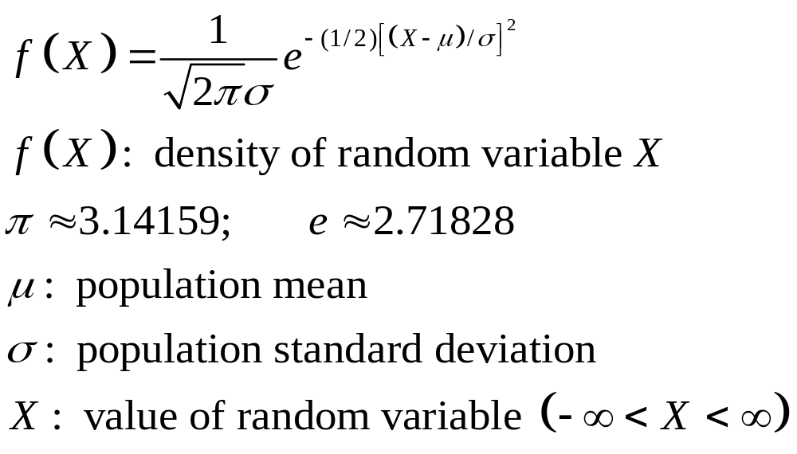
The Mathematical Model

Slide 22
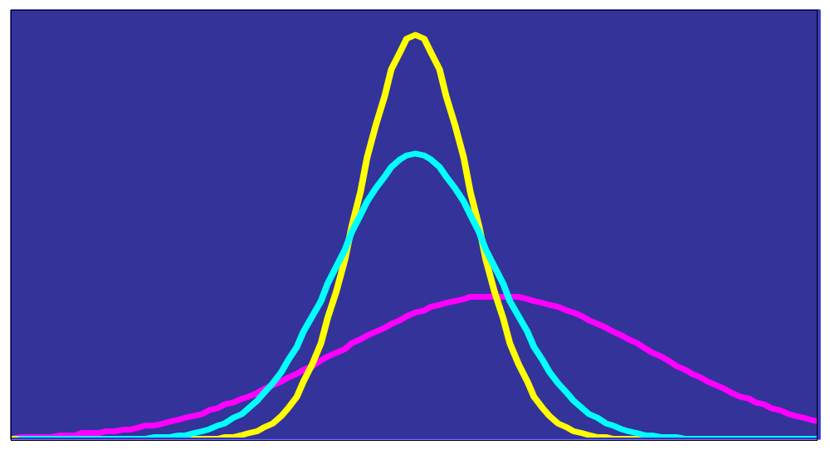
Many Normal Distributions
There are an Infinite Number of Normal Distributions
Varying the Parameters σ and μ, we obtain Different Normal Distributions

Slide 23
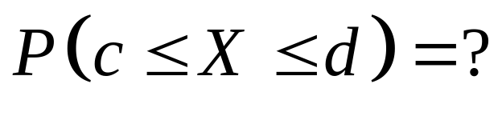
Finding Probabilities
Probability is the area under the curve!
f(X)
X
c
d

Slide 24
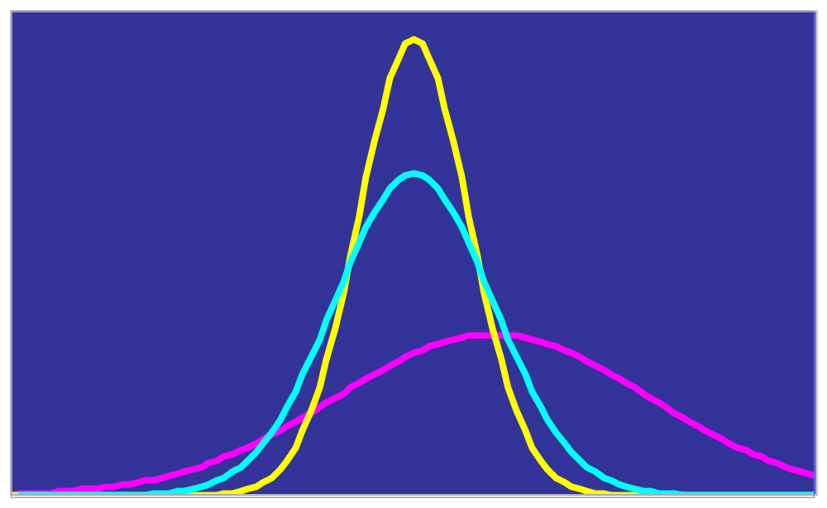
Which Table to Use?
Infinitely Many Normal Distributions Mean Infinitely Many Tables to Look Up!

Slide 25
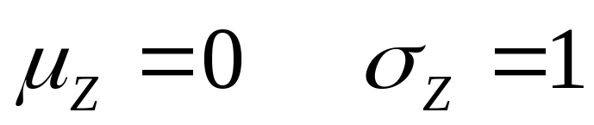

Solution: The Cumulative Standardized Normal Distribution
Cumulative Standardized Normal Distribution Table (Portion)
Z
.00
.01
.02
.5478
0.0
.5000
.5040
.5080
0.1
.5398
.5438
.5478
0.2
.5793
.5832
.5871
Probabilities
0.3
.6179
.6217
.6255
Z = 0.12
Only One Table is Needed

Slide 26
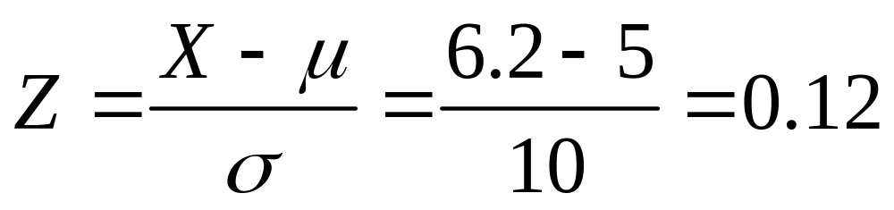
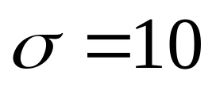
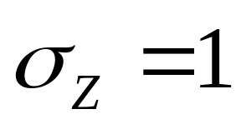




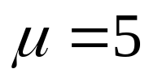
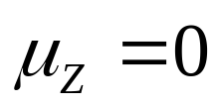
Standardizing Example
Normal Distribution
Standardized
Normal Distribution

Slide 27
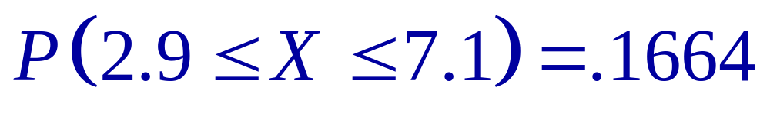
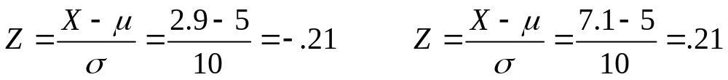





Example:
Normal Distribution
Standardized
Normal Distribution

Slide 28
Example:
(continued)
Cumulative Standardized Normal Distribution Table (Portion)
Z
.00
.01
.02
.5832
0.0
.5000
.5040
.5080
0.1
.5398
.5438
.5478
0.2
.5793
.5832
.5871
Z = 0.21
0.3
.6179
.6217
.6255

Slide 29
Example:
(continued)
Cumulative Standardized Normal Distribution Table (Portion)
Z
.00
.01
.02
.4168
-0.3
.3821
.3783
.3745
-0.2
.4207
.4168
.4129
-0.1
.4602
.4562
.4522
Z = -0.21
0.0
.5000
.4960
.4920

Slide 30
Normal Distribution in PHStat
PHStat | Probability & Prob. Distributions | Normal …
Example in Excel Spreadsheet

Slide 31
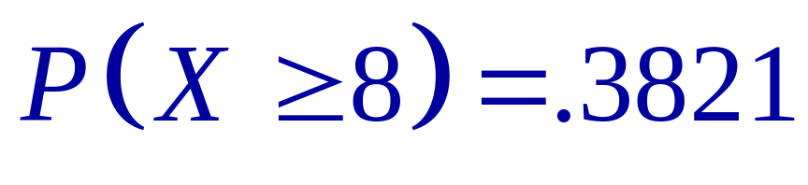
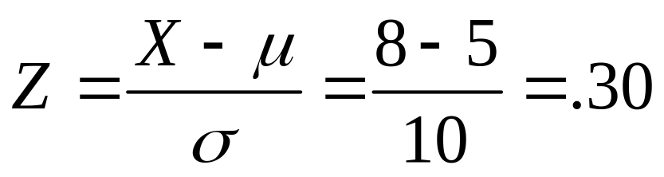



Example:
Normal Distribution
Standardized
Normal Distribution

Slide 32
Example:
(continued)
Cumulative Standardized Normal Distribution Table (Portion)
Z
.00
.01
.02
.6179
0.0
.5000
.5040
.5080
0.1
.5398
.5438
.5478
0.2
.5793
.5832
.5871
Z = 0.30
0.3
.6179
.6217
.6255

Slide 33

Finding Z Values for Known Probabilities
Cumulative Standardized Normal Distribution Table (Portion)
What is Z Given Probability = 0.6217 ?
Z
.00
.01
0.2
.6217
0.0
.5000
.5040
.5080
0.1
.5398
.5438
.5478
0.2
.5793
.5832
.5871
0.3
.6179
.6217
.6255

Slide 34


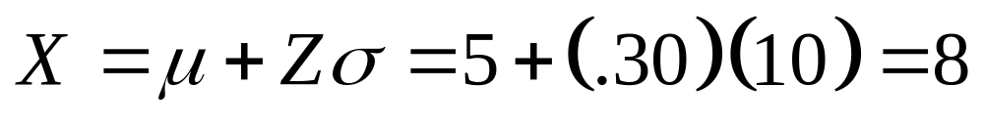
Recovering X Values for Known Probabilities
Normal Distribution
Standardized
Normal Distribution

Slide 35
Assessing Normality
Not All Continuous Random Variables are Normally Distributed
It is Important to Evaluate how Well the Data Set Seems to be Adequately Approximated by a Normal Distribution

Slide 36
Assessing Normality
(continued)
Construct Charts
  For small- or moderate-sized data sets, do stem-and-leaf display and box-and-whisker plot look symmetric?
  For large data sets, does the histogram or polygon appear bell-shaped?
Compute Descriptive Summary Measures
  Do the mean, median and mode have similar values?
  Is the interquartile range approximately 1.33 σ?
  Is the range approximately 6 σ?

Slide 37

Assessing Normality
(continued)
Observe the Distribution of the Data Set
  Do approximately 2/3 of the observations lie between mean 1 standard deviation?
  Do approximately 4/5 of the observations lie between mean 1.28 standard deviations?
  Do approximately 19/20 of the observations lie between mean 2 standard deviations?
Evaluate Normal Probability Plot
  Do the points lie on or close to a straight line with positive slope?

Slide 38
Assessing Normality
(continued)
Normal Probability Plot
  Arrange Data into Ordered Array
  Find Corresponding Standardized Normal Quantile Values
  Plot the Pairs of Points with Observed Data Values on the Vertical Axis and the Standardized Normal Quantile Values on the Horizontal Axis
  Evaluate the Plot for Evidence of Linearity

Slide 39
Assessing Normality
(continued)
Normal Probability Plot for Normal Distribution
90
X
60
30
Z
-2
-1
0
1
2
Look for a Straight Line!

Slide 40
Normal Probability Plot
Left-Skewed
Right-Skewed
90
90
X
60
X
60
30
Z
30
Z
-2
-1
0
1
2
-2
-1
0
1
2
Rectangular
U-Shaped
90
90
X
60
X
60
30
Z
30
Z
-2
-1
0
1
2
-2
-1
0
1
2

Slide 41
Chapter Summary
Addressed the Probability of a Discrete Random Variable
Defined Covariance and Discussed its Application in Finance
Discussed Binomial Distribution
Discussed the Normal Distribution
Described the Standard Normal Distribution
Evaluated the Normality Assumption

